Slide 1
ENGL1200 IMAGINED WORLDS
GEN AI
This is a living document: 18 July 2024

Slide 2
What is AI?
Artificial Intelligence (AI) is already integrated into many tools we use every day.
Traditional AI
Follows set rules and is good at specific tasks with known results.
E.g. screen readers, autocorrect on your phone, voice commands with Siri or Alexa, and GPS in cars.
‘Generative AI’ (or Gen AI)
It can adapt and generate unpredictable outputs.
It learns the underlying patterns and associations from massive datasets, then uses these to create new images, video, text, music, programming code and even speech.

Slide 3
Use of ai in this course
01

Slide 4
Permitted use in this course
For learning and assessment:
This course allows the appropriately acknowledged and best practice use of Gen AI for all forms of written work, for the following reasons:
Use of Gen AI will rapidly become widespread in a range of professional and educational contexts
It is worthwhile (though not a requirement of this course) to understand how to use it appropriately and effectively, and to understand its limitations
Gen AI can serve as a useful starting point, but reliance on Gen AI will result in poor quality work, and especially work that is generic, unimaginative, in short: predictable
Assessments in this course emphasize original research prompted by individual curiosity and personal response, for which Gen AI has limited effectiveness
Assessments in this course will encourage students to take a position on a particular topic, rather than the ‘false balance’ or ‘bothsidesism’ of algorithmically generated arguments (and low-quality or biased media reporting)

Slide 5
Best Practice when using Generative AI
See: https://www.anu.edu.au/students/academic-skills/academic-integrity/best-practice-principles/best-practice-when-using
…
Ultimately, generative AI is a permissible learning tool, and can be cited as a research source. However, it is important to note the following:
Generative AI is not an academic source, hence may be inappropriate to cite or use in an assignment
Information produced by generative AI may be incorrect, unsubstantiated, or out of date
Therefore, using generative AI carries the risk of undermining your work and credibility as a researcher. Remember, assignment work is not simply creating an end product, but developing a suite of skills in time and workload management, critical thinking, reading and research, and academic writing along the way that will serve you across your degree and in your future careers.

Slide 6
Best Practice when using Generative AI
See: https://www.anu.edu.au/students/academic-skills/academic-integrity/best-practice-principles/best-practice-when-using
…
There are overlaps between actions considered breaches of academic integrity and use of generative AI. In particular:
Plagiarism - when we submit words or ideas copied, in part or whole, from other sources without acknowledgment
Ghost writing/contract cheating - when we submit work written or rewritten by another party, in part of whole, as our own.
Therefore, it is important to ensure we continue to research and write with integrity when using generative AI, as we would any source. Generative AI can support the research process, but should not substitute the research and especially writing process.

Slide 7
Best Practice when using Generative AI
See: https://www.anu.edu.au/students/academic-skills/academic-integrity/best-practice-principles/best-practice-when-using
…
Follow the steps below when using generative AI to ensure you are working with integrity.
Do Not | Do
Copy verbatim text produced by generative AI verbatim in your assignment Use text produced by generative AI as a substitute for your own research and writing Neglect to reference generative AI used in research | Use generative AI as a research/brainstorming prompt to guide you towards superior, substantiated sources Clarify what is deemed appropriate and inappropriate in your program/s and courses Ask yourself if your use of generative AI is consistent with the Best practice principles for learners Ask yourself if your use of generative AI overlaps with recognized breaches of academic integrity If you must incorporate information generated by generative AI in your paper paraphrase, summarise, or quote as you would any source reference as you would any source, following the Generative AI LibGuide

Slide 8
Acknowledgment
We develop our ideas through critically engaging with the work of others.
At ANU, we must act with academic integrity and reference and acknowledge the sources upon which their work is based.
We must acknowledge where AI has been used.
Principle 6 of the ANU resource on Generative AI and Data Governance states that, ‘Staff and students should be transparent about when and how AI has been used to create outputs’.
Generative AI and data governance: https://www.anu.edu.au/privacy/training-and-resources/generative-ai-and-data-governance
Generative AI Library Guide: https://libguides.anu.edu.au/generative-ai

Slide 9
Declaration – No Stigma!
An example of declaration:
I have used Generative AI tools to complete this assessment: YES/NO
If answered, ‘YES’, complete the declaration.
Declaration:
I acknowledge the use of [Copilot: https://copilot.microsoft.com ] to generate [use of GenAI].
The prompts I used were [list of prompts].
The output was used and/or adjusted to [explain use].

Slide 10
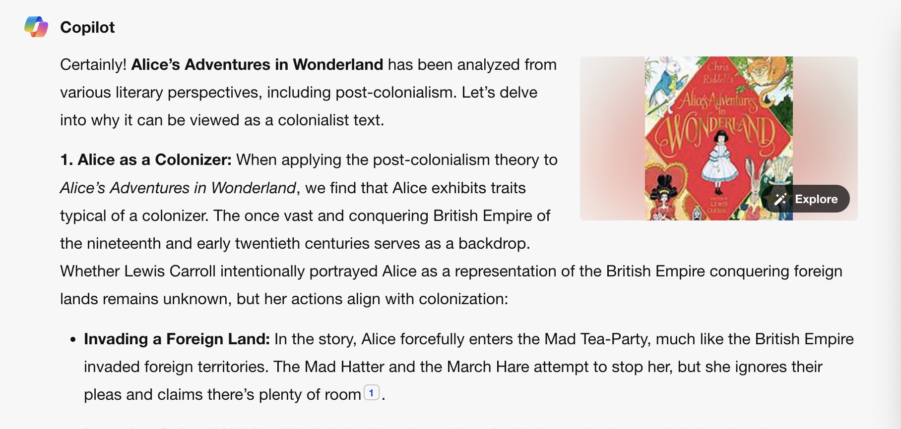
Gen AI example
Write a 500-word essay, with quotes and references, arguing why Alice in Wonderland can be viewed as a colonialist text

Slide 11
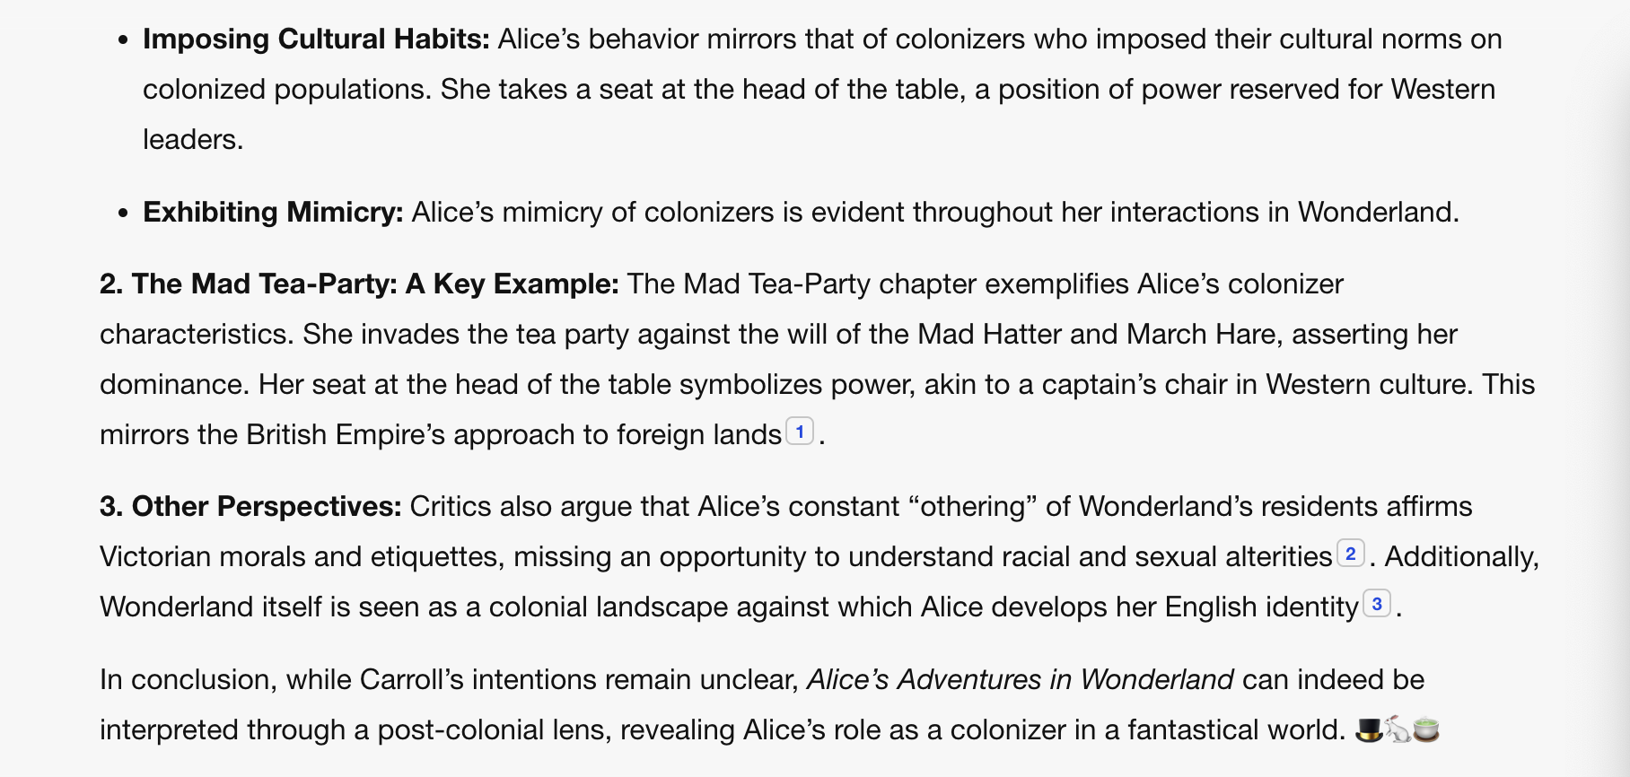
Gen AI example
Write a 500-word essay, with quotes and references, arguing why Alice in Wonderland can be viewed as a colonialist text

Slide 12
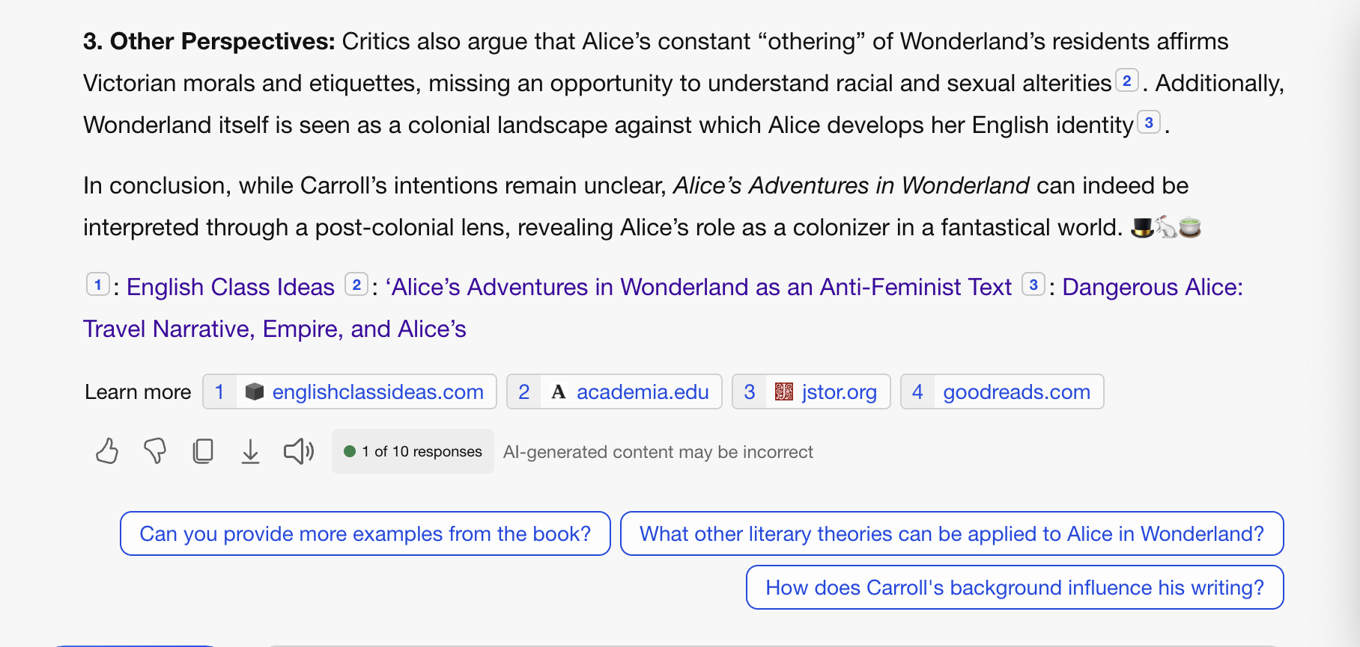
Gen AI example
Write a 500-word essay, with quotes and references, arguing why Alice in Wonderland can be viewed as a colonialist text

Slide 13
Gen AI example
Links:
https://www.englishclassideas.com/blog/literary-theory/post-colonialism
https://www.academia.edu/13958045/_Alice_s_Adventures_in_Wonderland_as_an_Anti_Feminist_Text_Historical_Psychoanalytical_and_Postcolonial_Perspectives_Women_A_Cultural_Review_Vol_27_no_2_2016_177_201_UK_peer_reviewed_ESCI_
https://www-jstor-org.virtual.anu.edu.au/stable/44378560?read-now=1

Slide 14
Academic integrity
Inappropriate use of AI is unacceptable and constitutes a breach of academic integrity.
If you submit AI-generated content as your own work, you are not submitting original work.
Under certain circumstances with approval, Gen AI can be used to support your research and writing process (for example: in suggesting an argument structure or an essay outline; or in providing an introduction to or summary of a topic that you will develop further through your own work; or even in drawing your attention to useful sources which you can then consult). However, it should not replace it.
Refer to ANU library Generative AI LibGuide and Best Practice when using Generative AI resource for further guidance or book an appointment with Academic skills if required.
Be prepared to provide evidence of your learning on the assessment task; for example, by showing notes/drafts/resource materials used in the preparation of the task or undertaking a viva voce assessment.

Slide 15
AI tools at ANU
Recommended AI tools to use at ANU
Copilot
Adobe Firefly
Non-endorsed AI tools require you to sign up and create an account and the ANU cannot guarantee your security and privacy when using these tools.

Slide 16
Copilot
Currently, Copilot Enterprise is available for all students.
It is important to sign in to Copilot with your work (ANU uID) account so that you have access to Commercial Data Protection.
This means that after your browser is closed, the chat topic is reset or the session times out. Your questions and prompts, and Copilot’s responses will also be discarded, and they will not be used as part of training Copilot’s underlying large language model.
However, you should still be cautious about the privacy and security of the content being put into generative AI tools, especially if it contains sensitive or confidential information.

Slide 17
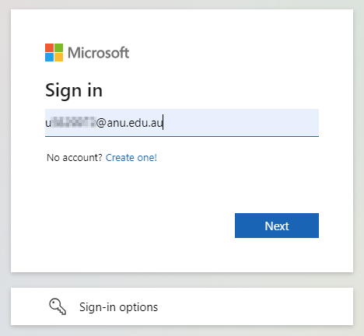
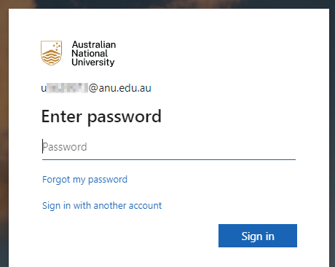
Login to Copilot
Navigate to https://copilot.microsoft.com.
Enter your ANU uID email address (i.e. your “u number” email address) and select “Next”.
You will then be taken to an ANU branded sign-in page. Your password will be your existing ANU account password. You will also have the option to “stay signed in” or not.
Once you are signed in, verify that you are in the Protected environment. There should be a notification in the top-right of the page. If you cannot see this notification, refresh your page and/or clear your browser cache and cookies.

Slide 18
Limitations of AI
02

Slide 19
Accuracy
The predictions and generated content may be inaccurate, incomplete and subject to bias.
AI is not a replacement for your own learning, thinking and research.
Always ensure you fact-check AI-generated content or sources.

Slide 20
Finding academic resources
AI will not be able to access any articles behind a paywall.
This will significantly limit the scope of the literature.
Do not rely on AI as a primary source of information as it may supply inaccurate or completely made-up examples, quotations or references. It is important to check them for yourself. Evidence of this in your written work will be treated as Academic Misconduct and will be marked accordingly – as a Fail.
If you wish to use Generative AI to help find academic resources, you can simply prompt it to “provide a list of peer-reviewed academic articles that address [x]”.
However, as Generative AI does not currently have ways of ranking findings for relevance or importance, you will be more likely to get a useful result using a search engine.

Slide 21
Retrospective
AI is trained on retrospective data, so it does not possess the same 'creativity' skills that humans do.
AI has a cut-off date and only knows information available before a certain date.
AI can access up-to-date information, but its ability to “think” is limited by the cut-off date.
AI has no way to judge the quality of searches.

Slide 22
Deskilling
AI for learning is meant to support you but cannot replace the skills you need to develop yourself:
Discipline-specific knowledge & skills
Adaptive thinking
Professional skills
Critical thinking
Problem solving
Academic skills including writing, reading, summarising, paraphrasing, etc.
Independent research
Remember often in the ‘real-world’ environment, we do not have these tools on hand.

Slide 23
AI and LITERARy studies
03

Slide 24
Bias in AI
AI systems are trained on massive datasets and therefore reflect the inevitable biases and lack of diversity present in that data
The biases often originate from the data used to train the AI, which does not represent all demographics equally. As a result,
the outcomes might inaccurately represent one group or prioritize one group over another
be mindful that these biases and the lack of diversity can affect how included (or excluded) different equity groups feel
Beware the promise of a technical fix:

Slide 25
Points for discussion
The following points are topics that have sparked many discussions around the use of AI. We encourage academic staff to discuss with students how AI can influence or impact the specific discipline area.
Some points for discussion include:
Transparency of selected training data [black box technologies using unknown/unknowable datasets and algorithms]
Ownership and creativity [privatization of the human commons]
Equity and access [the ‘digital divide’, PLUS: it’s free now, but…]
Privacy and security [you are training the machine, and the machine is learning about you]
Environmental considerations [International Energy Agency estimates data centre electricity consumption = Sweden]
Opportunities and challenges in this specific discipline [predictive model based on reproducing most probable patterns, tendency to amplify dominant norms and assumptions, reduce diversity (including vocabulary), eliminate eccentrics]

Slide 26
Q&A
Do you have any questions related to AI and use of AI in this course?

Slide 27
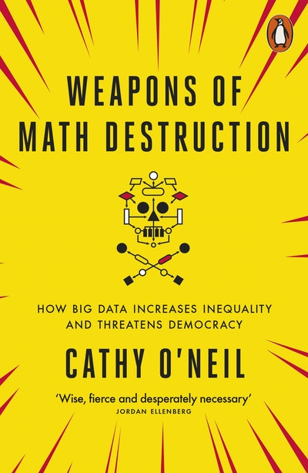
Recommended reading
Thao Phan, ‘Black Nazis, Asian Vikings & the white paranoia that haunts generative AI’: https://humanities.org.au/ power-of-the-humanities/black-nazis-asian-vikings-and-other-problems-with-generative-ai/
Hito Steyerl, ‘Mean Images’: https://newleftreview.org/issues/ii140/articles/hito-steyerl-mean-images

